Slide 1
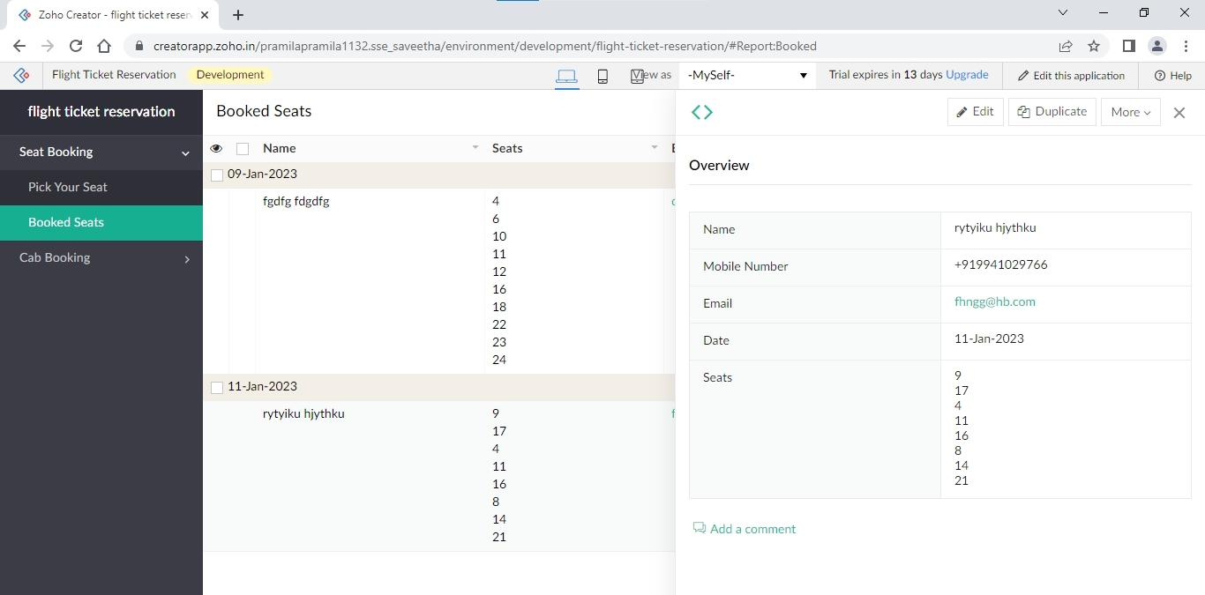
1. Flight Ticket Reservation

Slide 2
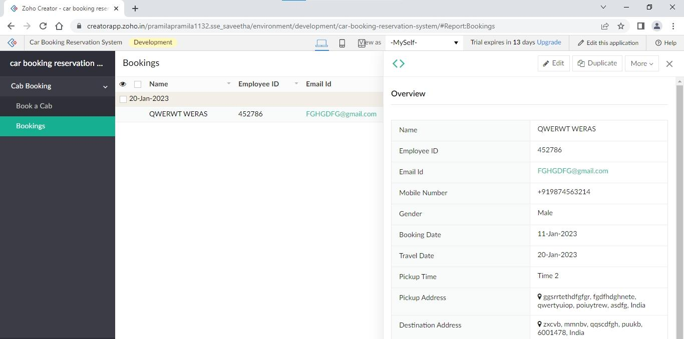
2. Car Booking Reservation System

Slide 3
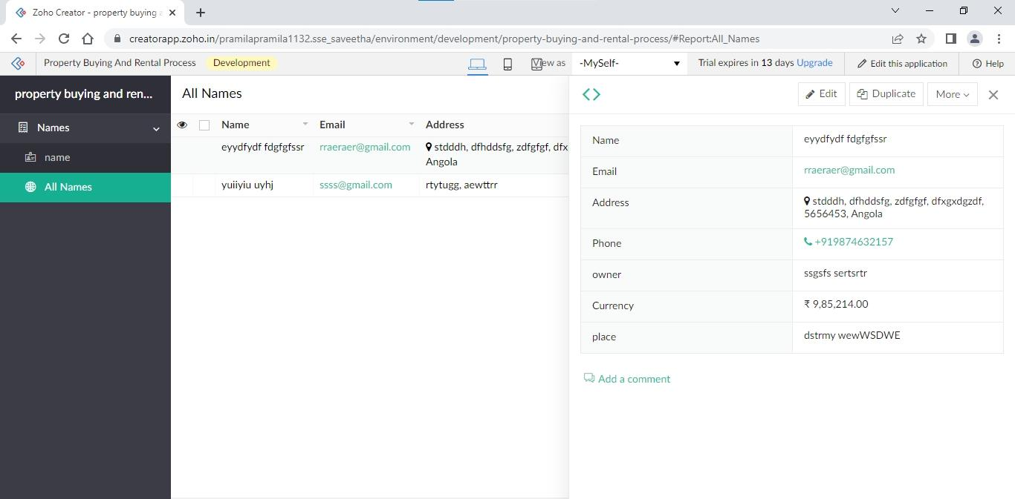
3. Property Buying and Rental Process

Slide 4
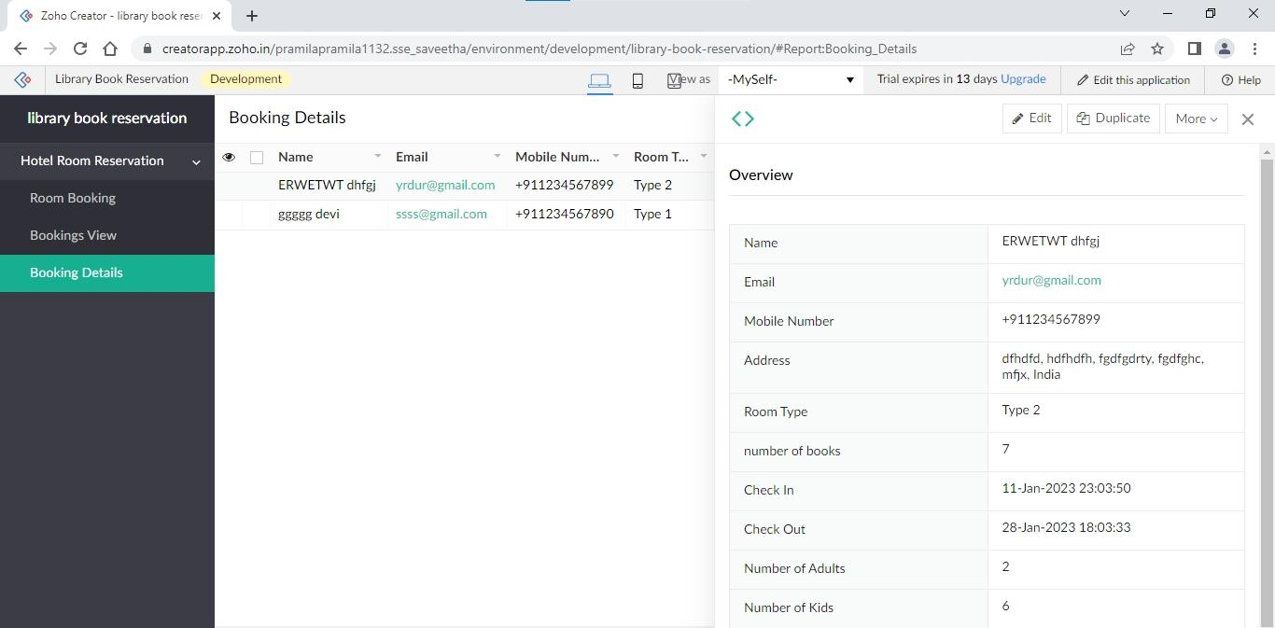
4. Library Book Reservation

Slide 5
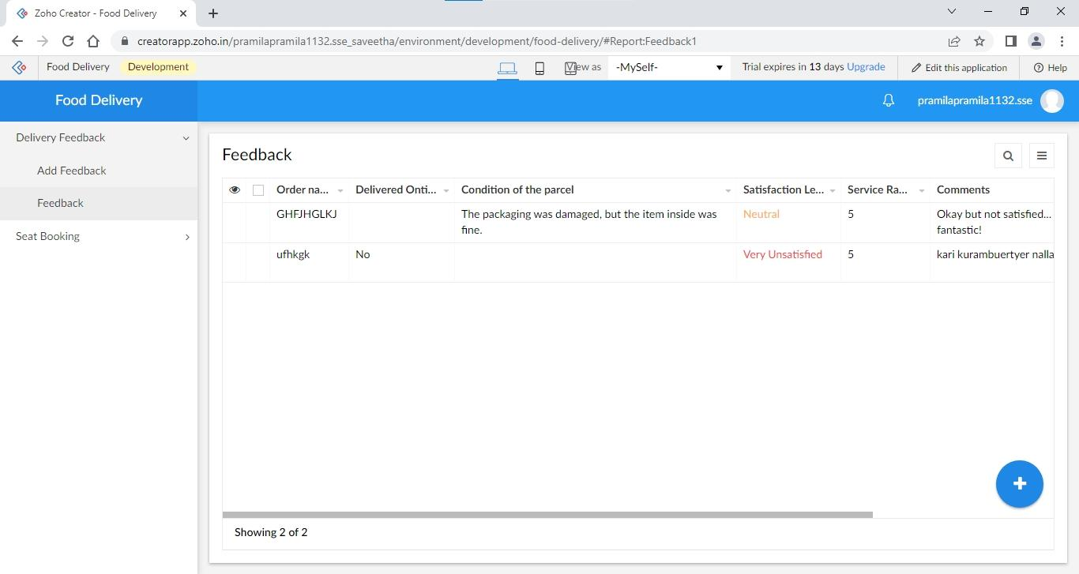
5. Food Delivery

